Slide 1
Timers
Dr. Federica Villa

Slide 2
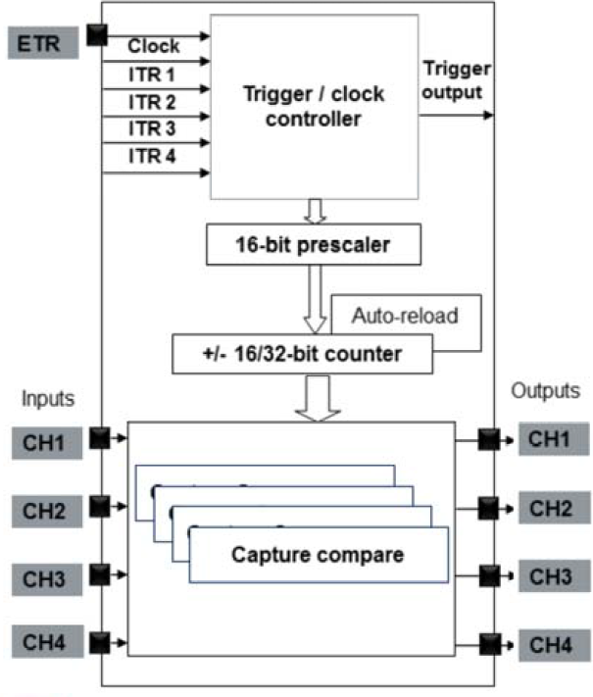
Timer structure
Trigger / clock controller
selects input clock
synchronization with other clocks (Master → Output Trigger Slave → Input Trigger)
Prescaler
Divides the frequency the counter increases, skipping a portion of the incoming events.
Counter
Up, Down, Up/Down counter
Capture and Compare registers
One for each channel
Auto-reload register
Sets the timer FSR
Notes:
Clock can be:
internal
external
from other TIM (ITR)

Slide 3
Timer block diagram
Clock and sync
Output stage
Input stage signal conditioning
Counter C&C
Notes:
ITR = internal trigger, to inter-connect different timers

Slide 4
Timers functionalities
Time base Generates triggers and interrupts at the overflow (or at the compare value) (e.g., trigger ADC conversion, software management, generic interrupts).
Input capture Capture the counter value in the capture register: - one input can be mapped to 2 capture channels - programmable edge sensitivity - event prescaler - digital filter
Output compare Every time that the compare value is reached: - corresponding output pin is SET/RESET/TOGGLE/UNCHANGED - generate an interrupt / trigger
PWM generation Edge aligned: counter Up or Down mode Center aligned: counter Up/Down mode

Slide 5
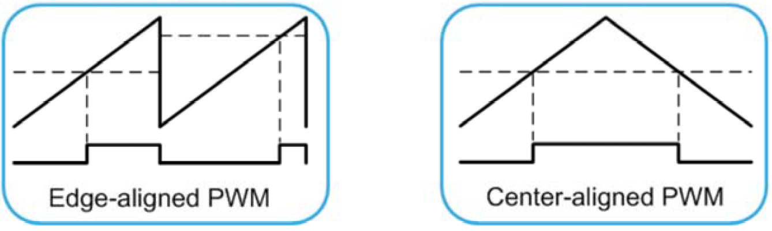
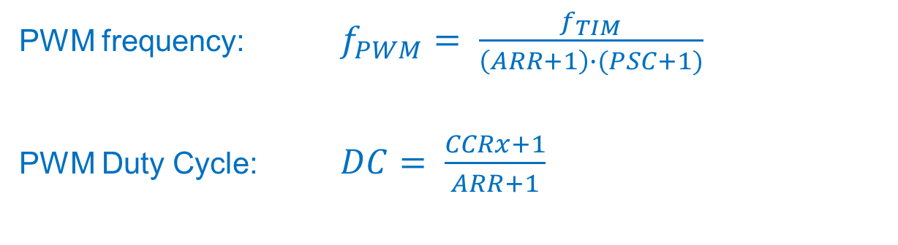
Pulse Width Modulator (PWM)
PWM frequency: $f_{PWM}= \frac{f_{TIM}}{\left(ARR+1\right)∙(PSC+1)}$
PWM Duty Cycle: $DC= \frac{CCRx+1}{ARR+1}$

Slide 6
Registers
Prescaler (PSC) Note that in order to divide by N the clock frequency you need to write N-1 in the Prescaler register
Auto Reload Register (ARR) FSR of the counter (counter overflow)
Capture / Compare Register (one for each channel) (CCRx) Capture = counter value when trigger is received Compare = counter value which generate an event (trigger or PWM commutation).
A complete list of the timer registers can be found in the Reference Manual.

Slide 7
Timer HAL functions
There are many HAL functions for timers.
In the next projects we will use the following functions:
HAL_StatusTypeDef HAL_TIM_PWM_Start(TIM_HandleTypeDef *htim, uint32_t Channel)
HAL_StatusTypeDef HAL_TIM_PWM_Stop(TIM_HandleTypeDef *htim, uint32_t Channel)
Starts(stops) the PWM signal generation
HAL_StatusTypeDef HAL_TIM_Base_Start(TIM_HandleTypeDef * htim)
HAL_StatusTypeDef HAL_TIM_Base_Start_IT(TIM_HandleTypeDef * htim)
HAL_StatusTypeDef HAL_TIM_Base_Stop(TIM_HandleTypeDef * htim)
HAL_StatusTypeDef HAL_TIM_Base_Stop_IT(TIM_HandleTypeDef * htim)
Starts(stops) the TIM Base generation (x_IT with interrupt generation).

Slide 8
Project 1c: Blinking LED - PWM
Objective of this project is to blink the NUCLEO board green LED at 1 Hz with 50% DC, using a PWM.

Slide 9
Project hints
Use the NUCLEO board Manual to find the GPIO connected to the green LED.
Set in CUBE the GPIO of the green LED as the output of a PWM
Check the TIMER clock frequency and configure the corresponding timer in order to obtain the required frequency and duty cycle.
Generate the c code.
In the main, start the correct channel of the timer connected to the LED.
Debug and verify the blinking frequency.

Slide 10
Project 2: Play note through speaker
Objective of this project is to play a tone using the speaker, using a PWM.

Slide 11
Project hints
Use the NUCLEO board Manual to find the GPIO connected to the speaker.
Set in CUBE the GPIO of the speaker as the output of a PWM
Check the TIMER clock frequency and configure the corresponding timer in order to obtain a 440 Hz tone (LA4 / A4 note) with 50 % duty cycle.
Generate the c code.
In the main, start the correct channel of the timer connected to the speaker. Stop it a few seconds later.
Debug and verify the note frequency. (Spectrum analyzer apps are easily available for smartphones)

Slide 12
Project 2B: Play a song
Objective of this project is to play a song using the speaker

Slide 13
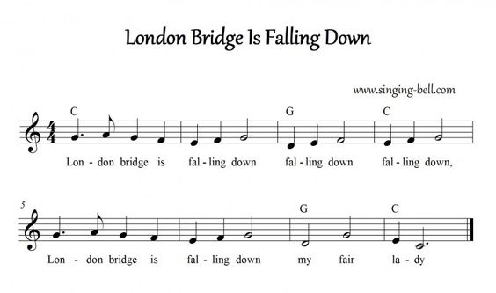
Suggested song score
Timer configuration for the various notes can ba computed using the file “Musical notes.xslx” available on WeBeep

Slide 14
Project hints
Start from the same configuration as in the previous project.
Identify the setup functions that initialize the timer frequency and pulse duration. Use the required code from those functions to create a new function to setup a new frequency and pulse duration of the timer.
Define a struct to store the note frequency and duration
Create an array of structs to store the song
Play the song by stepping through the array, every time setting the correct frequency and for the correct duration of the note.

Slide 15
Project 2C: Play a song (interrupt)
Objective of this project is to play a song using the speaker when the microphone detects a loud sound

Slide 16
Project hints
Start from the same configuration as in the previous project.
Setup the correct interrupt and using the correct callback, play the song
Is the song being played correctly? If not, try to debug your code and propose a possible solution to the problem.
If the song is playing correctly, does it stop at the end? If not, debug your code and propose a possible solution to the problem.

